Slide 1
Prediction of the Outcome of United State Security Clearance Appeals via NLP models
Julius Frank

Slide 2
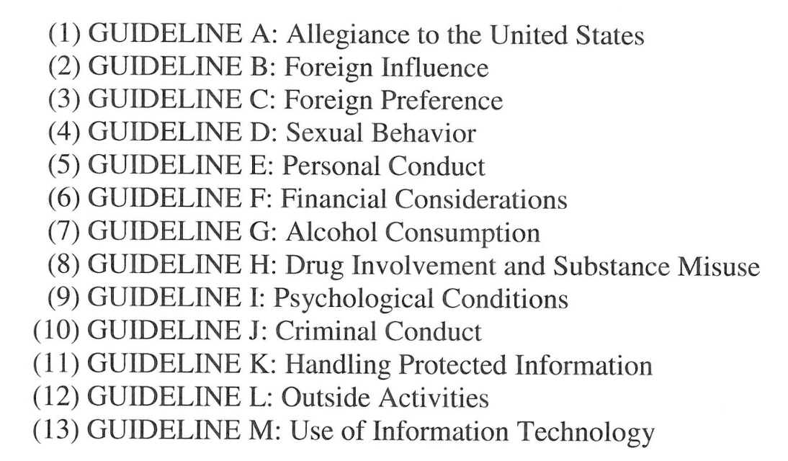
Introduction
All persons that work with classified information in the US must get a Security Clearance to be able to access classified information
Additionally, all Federal employees require a Public Trust clearance
These clearances can be denied for reasons falling under one of 13 guidelines
If a clearance is denied, the government must issue a Statement of Reasons (SOR) explaining what guideline the denial references and the details leading to the denial.
Source: Security Executive Agent Directive-4, The National Counterintelligence and Security Center

Slide 3
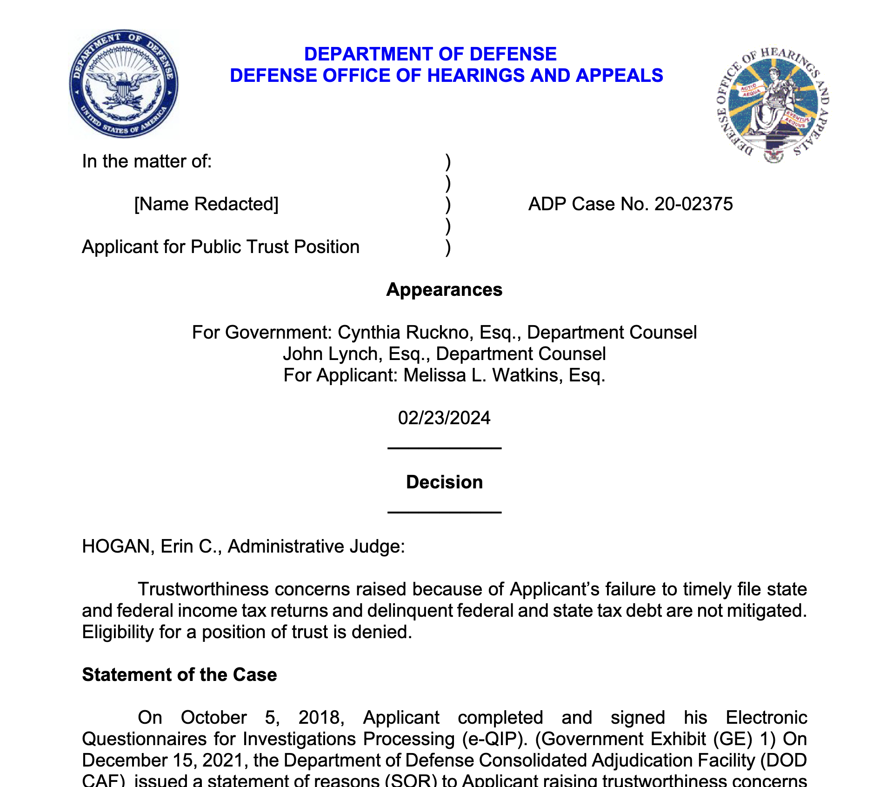
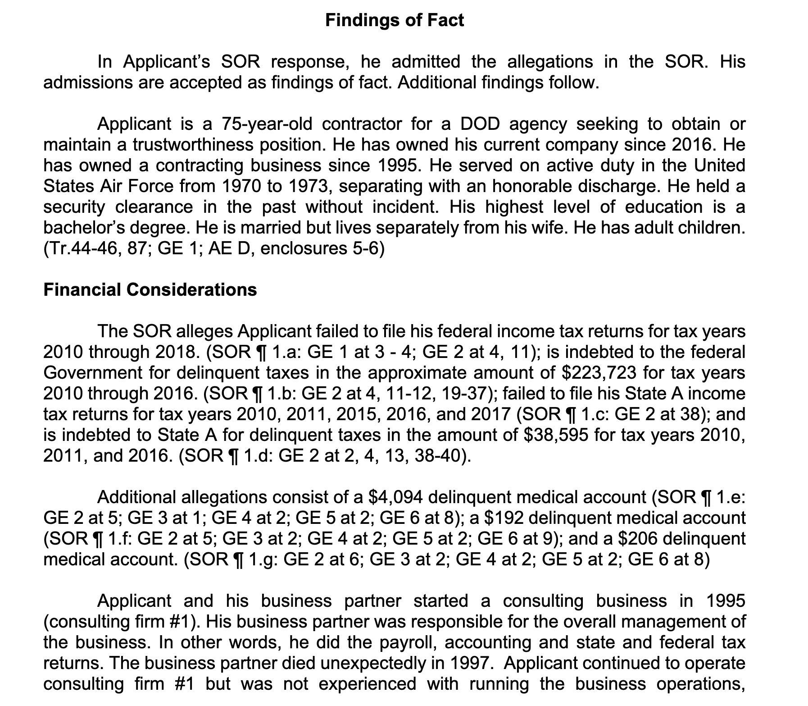
Appealing after receiving an SOR
Applicants have the right to appeal a denial of clearance after being issued an SOR. They will then stand trial by a judge from the Defense Office of Hearings and Appeals (DOHA) to make their case for why they should be granted a clearance
These case files are posted to DOHA’s website and are freely available to the public.
These files contain Findings of Fact section where the details of the clearance denial are laid out
This project will aim to develop NLP models to predict the decision of hearings based on their Findings of Fact
Two models are investigated:
Long Short-Term Memory (LSTM) Networks
Logistic Regression (LR) via TF-IDF feature extraction

Slide 4
Data Collection and processing
All hearings from 2019 to the present were downloaded from DOHA’s website and processed using pdfminer.six
Text in parathesis was removed to take out legal citations
For LR models only, spacy was used for lemmatization
End dataset characteristics:
Training: 915 approvals, 2563 denials
Evaluation: 245 approvals, 662 denials
Keep in mind that denial is the positive class and is represented as 1

Slide 5
Handling class Imbalance
As seen, the dataset is massively imbalanced, denials outnumber approvals 3:1
For LR models, sklearn provides easy ways to apply class weights by simply passing class_weight=‘balanced’
LSTM models class weights ended producing minimal effects, so weight sampling was used such that models would get the same proportion of deny and approve samples in a batch
Models can receive the same FoFs more than once in an epoch
May lead to overfitting, but we will see why this was not a large concern

Slide 6
LR Hyperparameters
The only LR hyperparameters modified were discrete, namely:
The penalty term (lasso vs elastic net vs ridge)
The minimum n for the TF-IDF vectorizer
The maximum n for the TF-IDF vectorizer
For the LSTM models on the other hand…

Slide 7
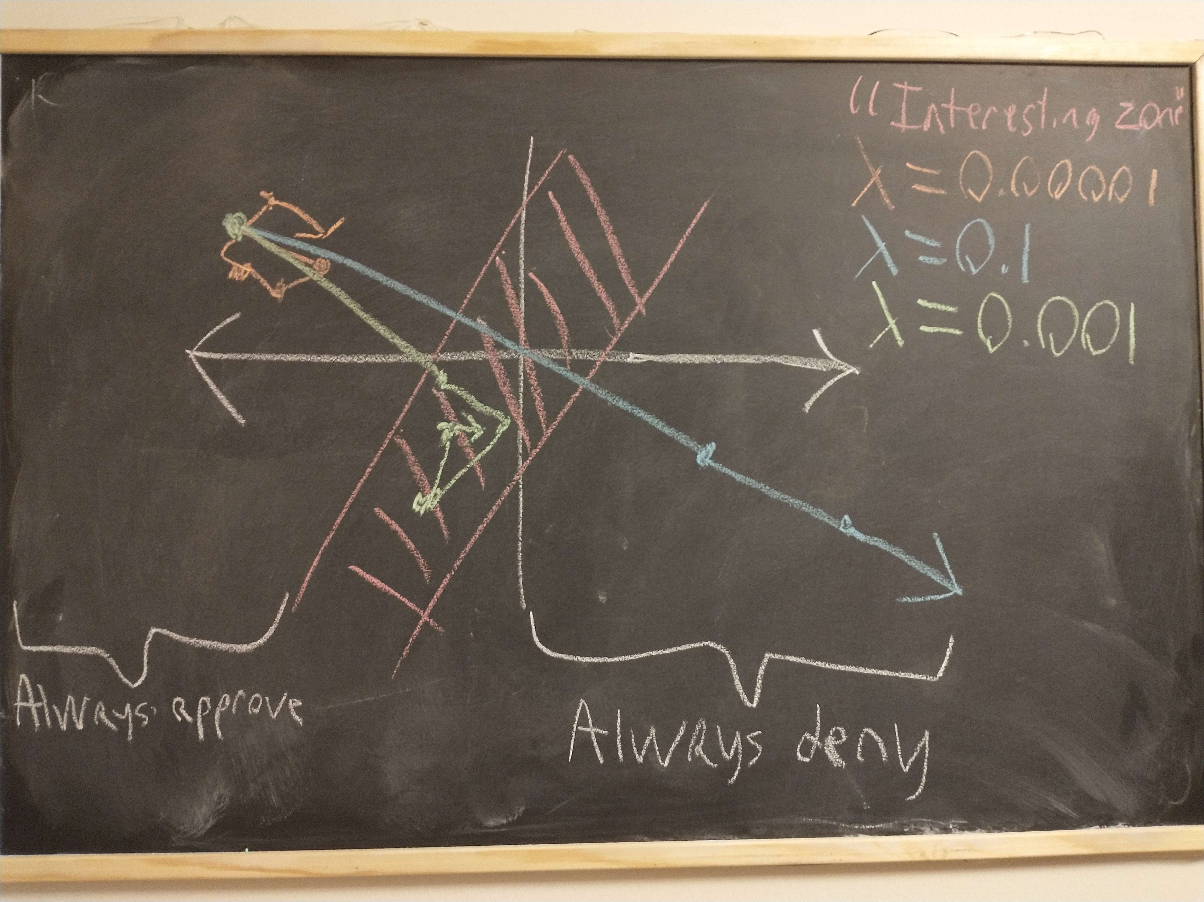
Learning Rate Sensitivity for LSTM
The “interesting” portion of weight space of the models is “narrow”
Because of this, overfitting is not a primary concern, since the LSTM models had trouble fitting, let alone overfitting
Still tune dropout rate once a “good” learning rate is set
Example low learning rate behavior
P tensor([0, 0, 0, 0, 0, 0, 0, 0, 0, 0]) Batch 75 Epoch 9
T tensor([0, 0, 1, 0, 1, 0, 0, 1, 1, 1]) Batch 75 Epoch 9
A tensor(0.5000) Batch 75 Epoch 9
P tensor([0, 0, 0, 0, 1, 0, 0, 0, 1, 0]) Batch 76 Epoch 9
T tensor([0, 1, 1, 0, 1, 0, 1, 1, 0, 1]) Batch 76 Epoch 9
A tensor(0.4000) Batch 76 Epoch 9
P tensor([0, 0, 0, 0, 1, 0, 0, 0, 0, 0]) Batch 77 Epoch 9
T tensor([0, 0, 1, 1, 1, 1, 1, 1, 0, 1]) Batch 77 Epoch 9
A tensor(0.4000) Batch 77 Epoch 9
P tensor([0, 0, 0, 0, 0, 0, 0, 0, 0, 0]) Batch 78 Epoch 9
T tensor([1, 1, 0, 0, 0, 1, 0, 0, 1, 0]) Batch 78 Epoch 9
A tensor(0.6000) Batch 78 Epoch 9

Slide 8
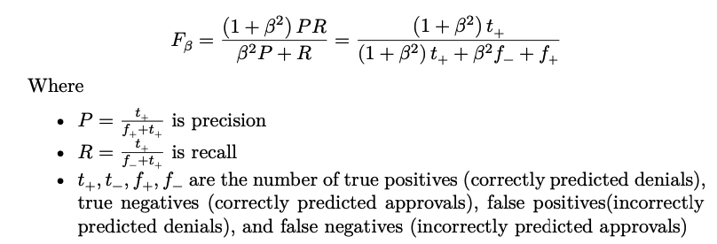
Model Judgement
Recall is much more important than precision
Don’t want to give classified information to people who shouldn’t have it!
But also, don’t want to reject qualified applicants if problems are successfully mitigated
Fβ score: modification of F1 that says recall is β times more important than precision

Slide 9
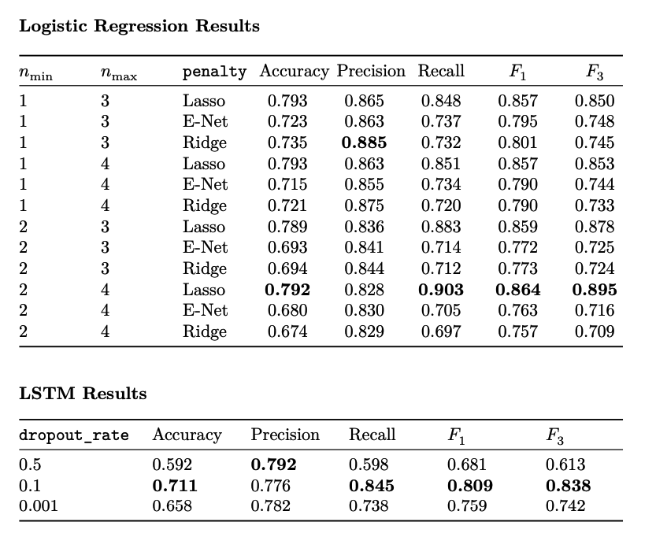
Results
LR outperforms all LSTM models
Interpretation: few “red flags” determine decision
Can be seen by looking at n-gram weights in best LR model

Slide 10
Content Warning
The following section will make references to in minimal detail
Child exploitation
Sexual assault
Sexism
Drug Abuse
Potentially Controversial Foreign Policy Issues

Slide 11
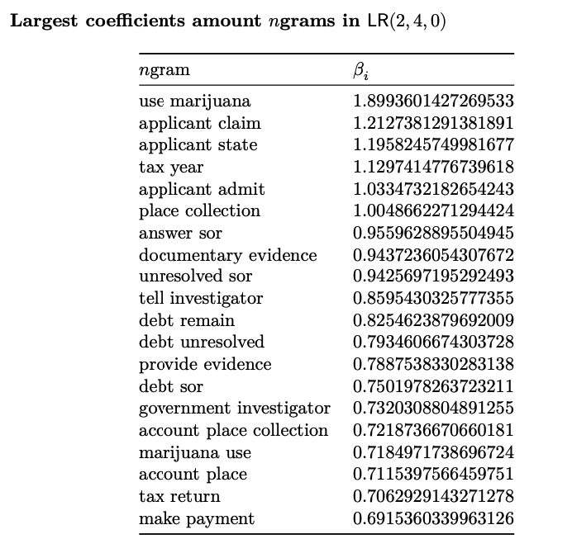
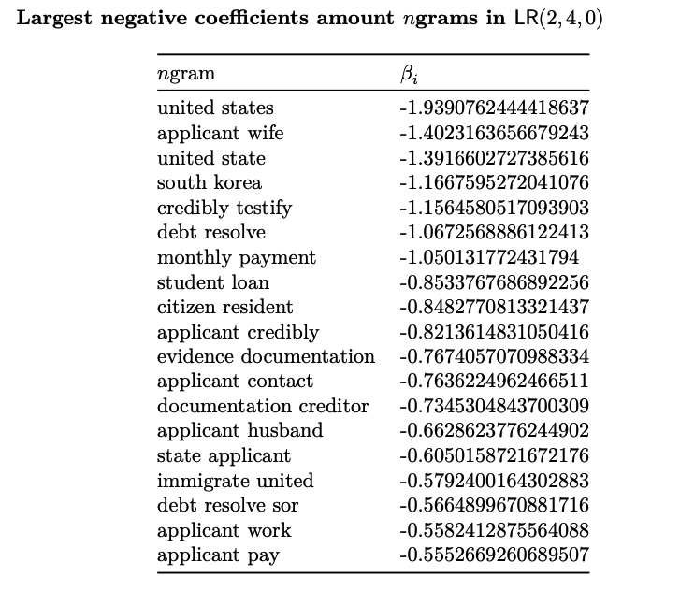

Slide 12
Problems of Model
Gender (and other sociological) bias
“applicant wife” has greater effect on approval than “applicant husband”
Underestimation of how problematic some ngrams are due to rarity
“use cocaine” and “use lsd” have coefficients 100% less in magnitude than “use marijuana”
“child pornography” has a lesser magnitude coefficient than all the above drug ngrams
“sexual harassment” has a negative coefficient, meaning it increases the chance of clearance approval

Slide 13
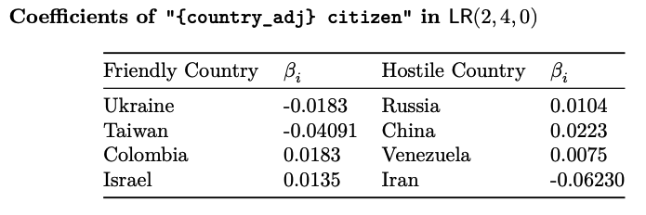
Quick digression on Foreign Influence

Slide 14
Conclusion
LSTM models are outperformed by LR models due to concentration of denials in a few “red flags”
Best LR preform well, achieving recall of 90% and F3 of 0.89
But it is clear the model is far from robust

Slide 15
Suggestions for improvement
Utilize transformer models that can be fed clearance guidelines before fitting
Adopt “Rationale Extraction” paradigm common in other legal judgement models
Divide model into sub-models for each security guideline
Clean data of information on protected characteristics (except nationality, for obvious reasons)

